Slide 1
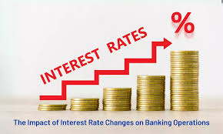
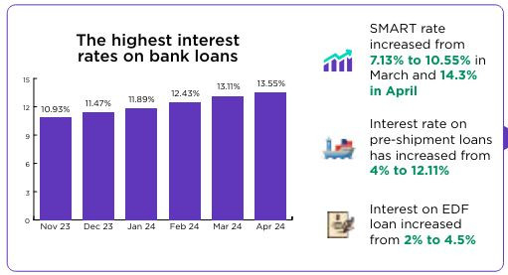
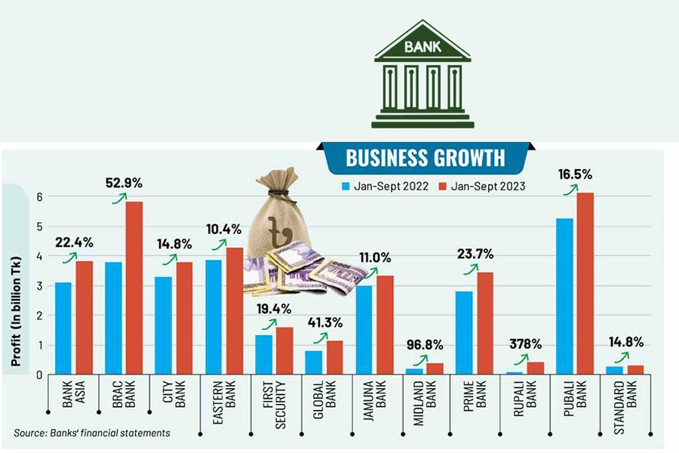
“ Impact of changing interest rate on bank’s performance- An empirical study on commercial banks in Bangladesh”
Moreum Akther
Department of Finance and Banking
University of Barishal
Objective
To determine how banks' performance is affected by interest rate fluctuations from Bangladesh's point of view. To examine the short-term and long-term effects of interest rate changes on bank profitability.
Result
Changing interest rate significantly impacts the banks’ performance.
Abstract
To determine how much a bank’s performance is influenced by changing interest rates. Changing interest rate significantly impacts the banks’ performance.
Hypothesis
H_{1a} | A significant relationship between IRS and ROA
H_{1b} | A significant relationship between IRS and ROE
H_{2a} | A significant relationship between GDPG and ROA
H_{2b} | A significant relationship between GDPG and ROE
NPY
POMC
Research Methodology
Y= Β₀+ Β₁ X_{1T}+ Β₂X_{2T}+ Β₃X_{3T}+ Β₄X_{4T}+ Β₅X_{5T}+ Β₆X_{6T} + Β₇X_{7T} + €
Here, Y= Dependent variable (ROA & ROE)
Β₀= Regression constant
X_{1T}= Interest Rate Spread, X_{2T}= Investment To Total Assets, X_{3T}= Loan & Advances To Total Assets, X_{4T}= Maximum Lending Rate, X_{5T}= GDP Growth Rate, X_{6T}= Deposit To Total Assets and X_{7T}= Loan To Deposit Ratio
Limitations
It has been seen that without interest rate spread other variables are insignificant for most of the analyses.
Different analytical tools can be used.
More observations should be considered to conduct this study.
Recommendation
Some of the variables from the analyses were insignificant in this study. A large number of samples should be taken into considerations. Many more analyses should be included to ignore the inconsistency.
Findings
It is found that there is a significant relationship based on the analyses. This research on the impact of interest rate spread on profitability provides valuable insights for regulators, bankers, financial analysts, and scholars.

